Slide 1

2D Closest Pair using {Divide AND Conquer}
Name: Ahmed Adel Azab
ID: 210165

Slide 2


Slide 3
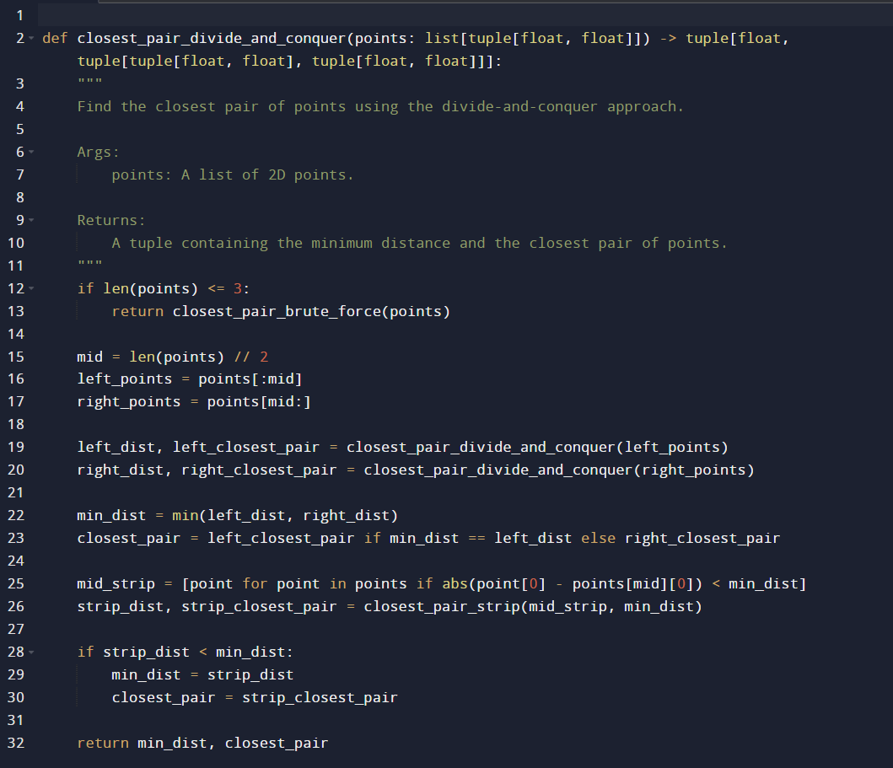

Slide 4
Analysis
T (n) = 2T (n/2) + f (n)
(with a = 2, b = 2, and d = 1)
we get T (n) ∈ (n log n).

